Slide 1
Developing a Fundraising Strategy

Slide 2
Course Outline
Why plan?
Strategy Development Process
7 step process for developing a fundraising strategy
- tools/examples/activities related to each step
Korean case-study
Group Exercises
Q & A

Slide 3
Why do we need a Plan?

Slide 4
Why do we need a Plan?
Provides a road map
Sets direction
Helps gain commitment from all stakeholders
Helps Board and Management make informed choices
Determines how resources are used
Helps to ascertain criteria to be tracked and evaluated

Slide 5
Strategy Development Process

Slide 6
GROUP ACTIVITY
What are the key components
of strategy development?
https://www.youtube.com/watch?v=7b0ASMc2sWA

Slide 7
Strategy Development Process
Strategic Thinking
What could happen?
Strategic Decision Making
What will be done?
Strategic Planning
How it will be done?
OPTIONS GENERATION
DECISIONS
ACTIONS

Slide 8
Key components of
fundraising strategy development
Focus the ‘case for fundraising support’ on issues important to your organisation's vision
Realistically assesses the organisation's strengths, weakness and external factors that can help or hinder fundraising
Carefully considers available organisational resources and its effective usage
Action oriented fundraising plan with emphasis on impact and results that program can deliver
On-going review and learning for future program and its impact on fundraising plans

Slide 9
The Korean Experience

Slide 10
Developing a
Fundraising Strategy

Slide 11
A step by step process
Where are we now?
Where are we going?
How will we get there?

Slide 12
Building blocks of fundraising
People
Planning
Infrastructure
Cost
Staff
Board
Volunteers
Software
Hardware
Direct cost of FR activities

Slide 13
Fundraising strategy development process
1. Analysis
1a. Fundraising History
1b. Program portfolio
1c. Fund-raising portfolio
2. Identify fundraising priorities
3. Set fundraising objectives (Why)
4. Formulate fundraising targets (Where)
5. Develop the Strategies (What )
6. Implement details (How)
7. Evaluate (How Come)

Slide 14
1.a. ANALYSIS – Past records
Source
Recency
HISTORY
Monetary value
Frequency

Slide 15
1.b. ANALYSIS– Current Program
Urgent need
Key Program Pillars
PROGRAM
Critical need
Long-term vision

Slide 16
Vision
A shared hope and an image of the future that’s what is pulled together by the organisation’s vision statement

Slide 17
Mission
The mission gives the reason for the organisation’s existence.
It specifies the purpose of the organisation, what it does and who it serves.

Slide 18
1c : Current Fundraising
Analysis Tools
Trends (PESTLE)
Political
Economic
Social
Technological
Legal
Environment
Internal (SW)
Strengths
Weaknesses
External (OC)
Opportunities
Challenges

Slide 19
SWOC
Strengths
* What do you do well?
* What unique resources can you draw on?
* What do our stakeholders see as your strength?
* What fundraising skills do you have within your organisation
• Is the trends in fundraising income better year-on-year ?
• Is the door/supporter database strong?
Weaknesses
What could you improve?
Where do you have fewer resources than others?
What are others likely to see as your weaknesses?
Opportunities
* What opportunities are open to you?
* What trends could you take advantage of?
* How can you turn your internal strengths into external opportunities?
Challenges

Slide 20
2. IDENTIFY FR PRIORITIES
“
What is your income mix?

Slide 21
Matching organisational needs with fundraising direction
FR priority examples :
$
Reduce financial vulnerability
Widen income mix/scores
Increase fund-raising efficiency
Grow number of donors/ average gift
Increase sustainable funding sources

Slide 22
Organisational funding priorities | How can it be addressed through fundraising directions
1. Reduce financial vulnerability | Look at how to move away from over dependency on government or founder’s or one event based funding
2. Widen income sources | Look at how to add more methodologies through which funds can be raised
3. Increase fundraising efficiency | Look at how more funds can be raised by reducing the cost of fundraising per method
4. Increase number or donors and / or size of contributions ie: average gift size | Look at ways to build donor relationships that will increase outreach and / or increase levels of donations
5. Increase sustainable funding sources | Look at ways to move away from one-off / transactional donor relationships

Slide 23
3. SET FR OBJECTIVES
Case for support – USP (unique selling point)
Priority target audiences
Main fund-raising activities
Resource needs
Human
Material
Financial
Time-frame

Slide 24
The 5 Different Partners
Individuals
Companies
Foundations
Organizations
Government /
Statutory

Slide 25
Differentiate the 5 key Partners
 | Types of Gifts | Examples
 | Individuals - from personal wealth or income | One-off donors, regular donors, major gift donors , legacy donors
ii | Companies Through philanthropy budget , advertising budget or social responsibility budget | Multi-national Corporations (MNCs), Government-linked companies, Small-medium enterprise (SMEs)
iii | Foundations Grants allocated with the purpose of meeting needs in the community | Corporate foundations Family foundations Bi/ Multilateral funders Trusts
iv | Organisations Projects and programs funded to meet organisation’s mission of community engagement | Civic groups like LIONS , Rotary; Faith groups like Temples, Churches, Clan Associations
v | Government / Statutory Grants and subsidies given in line with national / policy directions | Grants from Ministries, National Councils, National /State Funds

Slide 26
4. FORMULATE FR TARGETS
Generate fundraising options
Test the Options
Tools for options generation
Sources – target-setting
Individual
Corporate
Foundations – Community, Family, Corporate
Organizations – Faith groups, Civic organizations
Public sector / Government / Bi- & Multilateral
Short-term (1 year) / Long-term (3 years)

Slide 27
Tools for Option Generation
Tool: Brainstorming – Individual / Group - generate ideas
Tool: Starbursting – consider relevant aspects of an idea before any work begins on developing it as an option
Tool: Decision Matrix Analysis – evaluate alternatives and choose best option
Sources – target-setting
Individual
Corporate
Foundations – Community, Family, Corporate
Organizations – Faith groups, Civic organizations
Public sector / Government / Bi- & Multilateral
Short-term (1 year) / Long-term (3 years)

Slide 28
STARBURST METHOD
Who are we targeting?
Who will develop this idea?
Who’s support do we need?
Who else is already doing this?
What do we call it?
What $ level do we pitch it at?
What criteria do we use to evaluate?
How does it help meet FR needs?
How does it use our strengths?
How will we promote it?
Why has this idea not been tried before?
Why will donors participate?
Why won’t they participate?
Where will we pilot this?
Where will we find the investments for this?
Where are the blind-spots/ risks?
When do we need to launch this?
When do we evaluate?
When are the various milestones?
Generating questions rather than answers.

Slide 29
DECISION MATRIX ANALYSIS
FACTORS |  |  |  |  |  | TOTAL
Event 1
Event 2
Event 3
Venue
Cost
Committee
Volunteers
Entertainment
WEIGHT
Systematically identify, analyze, and rate options

Slide 30
Generate Strategic Options
- some FR examples

Slide 31
Goals
Help the organisation measure its success in serving its mission and thereby achieving its vision.
Concrete steps to take towards meeting the mission.

Slide 32
Are your goals S.M.A.R.T.?
Specific: clear and unambiguous
Measurable: to measure progress and results
Attainable: realistic, i.e. neither out of reach nor below standard performance
Relevant: in line with mission and vision
Time-bound: with “milestones” and deadlines

Slide 33
Types of FR by other NGOs in Asia
Special events
Product Sales
Subscription, membership
Mail /Media Campaign
Rental of facility
Trg & Consultancy
In-kind Donations
Savings and Credit
Publications
Tours (eco )
Payroll giving
Sponsorships /Corporate
Grant writing
Publications
Payroll giving
Training & consultancy
Tours (eco)
Grant writing
Product sales
Special events
In-kind donations
Savings & credit
Subscription, membership
Rental of facility
Mail/Media campaign
Sponsorships / Corporate

Slide 34
Cost per funds raised
ASIAN EXPERIENCE
Reasonable cost / $1
of donation raised
FR Activity

Slide 35
5. DEVELOP THE STRATEGIES- Fundraising Models
HEARTSTRINGS MODEL - Compelling ‘case’ in simple & concise way ( eg: make- a- wish / child sponsorship)
MEMBERSHIP MODEL- collective benefit (eg: arts/ culture org)
LARGE SCALE FUNDING MODEL: major grants from few individuals or foundations(eg: medical research institutions)
SOCIAL & POLICY SERVICE SUPPLIERS: provides preexisting programs with Govt. defined and allocated funds
RESOURCE RECYCLING MODEL: redistribution of products and supplies (eg: Foodbanks)
REVOLVING FUND MODEL: Repayments by beneficiary part of the funding model (eg: Habitat for Humanity)

Slide 36
12 Fundraising Techniques
Cause-related Marketing
Peer to Peer/ Crowd-sourcing
Sponsorship
Corporate Donations
Charity Draws
Special Events
Fee for Service
Telephone appeals
Planned Gifts
Direct Mail
E-mail
Workplace Giving
Merchandise
Major Gifts

Slide 37
6. Essential Implementation Details
Board involvement
Resource Development Committee
Fundraising Volunteer resource needed
Database application
Communications plan- including social media
Skills /resource leveraging within the organisation

Slide 38
Essential implementation details to consider | Examples of how this can be implemented
Board Involvement | Role of Board in giving and getting funds for meeting the mission
2. Resource Development / Fundraising committee | Depending on the methodology – mobilising relevant influential persons to lead the campaign – eg: Corporate CEO to help outreach for Corporate fundraising or High-net worth individual to promote the sale of Gala-dinner tables
3. Fundraising Volunteers | Involving volunteer champions to promote a specific campaign
4. Database applications | As a minimum get free database licence from Microsoft or Salesforce.com to develop a donor dbase
5. Communications plan – including Social Media | Have an editorial calendar of online posting / outreach activities / traditional media outreach
6. Leveraging skills and resources within the organisation | Build a constituency map to identify everybody in the VWO who can be of help to implementing the FR strategy

Slide 39
POLICIES

Slide 40
Prepare a check-list of FR related policies

Slide 41
Fundraising Related Policies
Sources of funding approval
Goal setting , plan & strategy approval
Decision on out-source v/s in-house FR
Compliance to legal requirements
Reserves policy
Oversight on funds raised
Tone of VWO message

Slide 42
FR related policies
Accountability to Donors
Approval of FR methodologies
Decision on FR Cost-Benefit analysis
Structure of FR support
Risk Management – Branding , Data Security , Long terms impact of current decisions
Ethical Fund-raising
Legal issues
Others ?

Slide 43
7. Evaluate
Track results
Review situation
Look for ‘opportunity’ variance
Look for negative variance
Take appropriate steps
Fine-tune next years FR plan

Slide 44
Monitoring Process
Need, Case, Cost
Record, Evaluate, Course-correction
Funding
sources
Targets,
Plan, Budgets
Methods,
People, Structure

Slide 45
Criteria for evaluation
Fit with mission
Scale of opportunity
Capacity to implement
Impact to organization
FR sustainability
Cash flow impact
Level of restriction to use / reporting
Return on investment
Timescale
Risk level
Costs
Synergy with other FR
Diversity of sources
Future potential

Slide 46
Do not mistake activity for achievement !
~ American basketball coach John Wooden

Slide 47
Output expected from
the Strategic Planning Process
Articulate Program Needs, Goals,
Results,
Impact
Evaluate
Document,
& make course-correction
Identify
Best fundraising options and prioritize it
Deliver on Targets,
Tactics,
Budgets
Finalize Methods,
People,
Structure

Slide 48
Output expected | Examples
Articulate | The program and its expected results and impact
2. Identify | The best fundraising options and prioritise it based on organisational realities
3. Finalise | The fundraising methods to be used, the people ( staff and volunteers ) needed to deliver it as well as the structure needed to implement the plans
4. Deliver | Deliver on the fundraising target set by implementing the tactics and staying within the budget agreed
5. Evaluate | Document the strategy and its implementation and make course-corrections as needed

Slide 49
Group Activity
Develop a fundraising strategy
Refer to The Beautiful Foundation (Korea) scenario

Slide 50
Using the Y-Tree Dashboard
Tactics
Strategy 1
Goal 1
Tactics
Strategy 2
Tactics

Slide 51
Format of Fundraising Strategy Paper
Strategy Paper
1. Introduction
WHY - Purpose of the Plan - in line with the Vision
WHAT - Resources needed
WHEN - Timeline
HOW - Activity
HOW MUCH - Targets & Fundraising Investment

Slide 52
2. Fundraising Aims & Objectives
Overall programmatic focus and need
Specific programs that need funding
Nonprofit’s fundraising needs
3. SWOC
What are you internal strengths/weaknesses as well as external opportunities/challenges

Slide 53
4. List your fundraising targets
5. Explain the strategies to be used to meet each of the targets
6. Provide the activities/tactics to be implemented to meet the targets

Slide 54
7. Time and Task plan
Time
Task
Infrastructure
Investment
8. Progress measurements
What will be tracked and hence to be captured?

Slide 55
9. Reporting format/timings
10. Contingencies
What is Plan B?

Slide 56
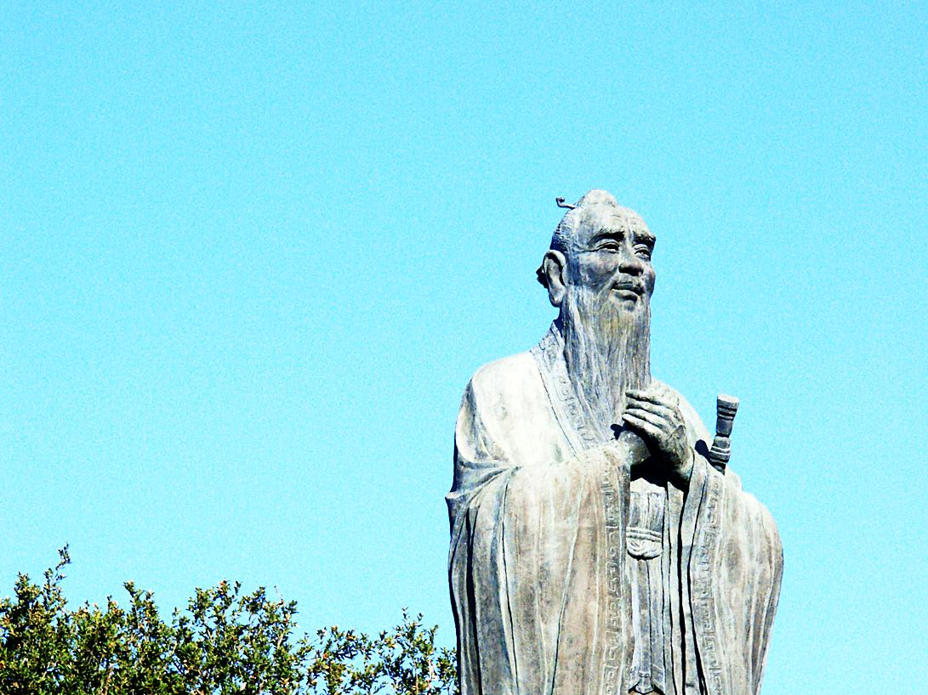
“
When it is obvious that the goals cannot be reached, don’t adjust the goals, adjust the steps.
- Confucius (551 – 479 BCE)
”

Slide 57
REVIEW THE SESSION
Questions ?

Slide 58
USHA MENON
Thank YOU!
umenon@ushamenonasia.com
@UshaMenon_Asia
www
www.ushamenonasia.com

